Slide 1
LAN Extension into a WAN
Establishing a Point-to-Point WAN Connection with PPP

Slide 2
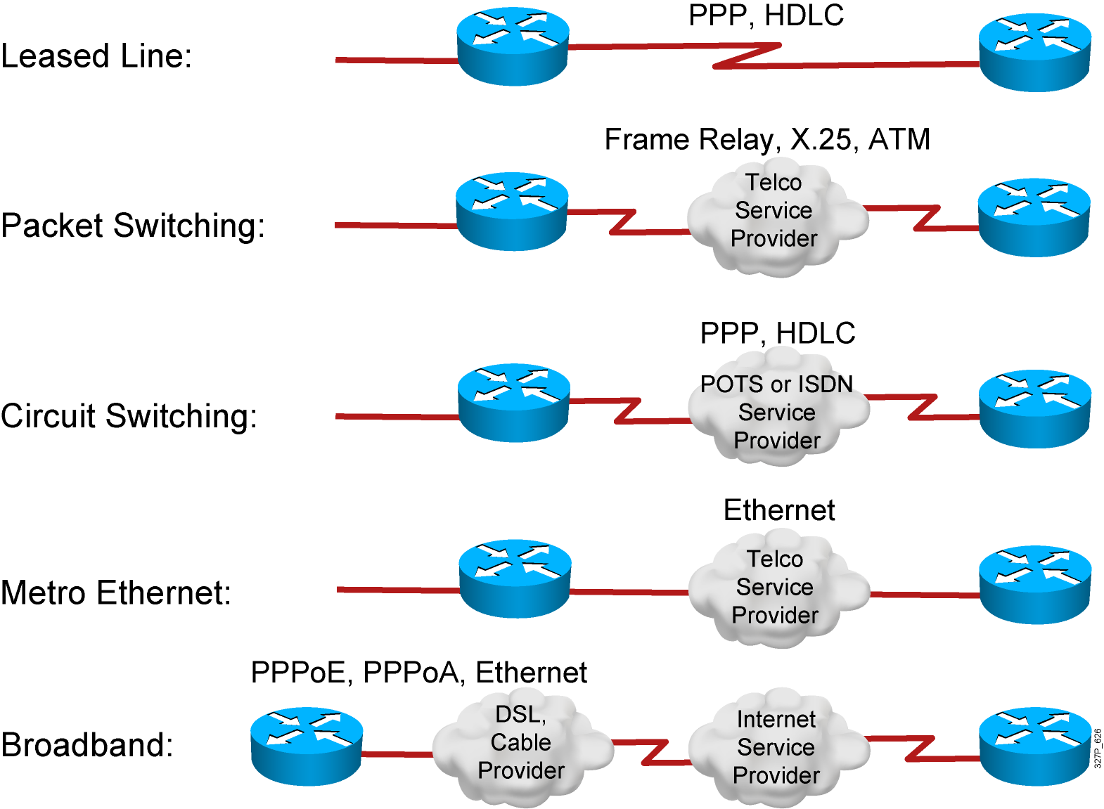
Typical WAN Encapsulation Protocols
Notes:
Purpose: This figure introduces students to various encapsulation options to use over the various physical connections.
Emphasize: In order to exchange traffic over a WAN link, the packets must be encapsulated into a Layer 2 frame. There are a variety of Layer 2 encapsulation types available that can be used, depending on the WAN connection being used. Some of the types are listed the figure.
Encapsulation must be configured on the router when configuring the interface. Some of these encapsulation types will be seen again in the following chapters.
In an ISDN environment, the Point-to-Point Protocol (PPP) is the B channel’s Layer 2 encapsulation. Link Access Procedure on the D channel (LAPD) is the encapsulation for the D channel.
Either the proprietary Cisco or Internet Engineering Task Force (IETF) (defined in RFC 1490) encapsulations are the Layer 2 encapsulations for Frame Relay.
Note: Other encapsulations not shown include AppleTalk Remote Access Protocol (ARAP), Compressed Serial Link Internet Protocol (CSLIP), or Synchronous Data Link Control (SDLC).
Transition: We will first look at the HDLC encapsulation.

Slide 3
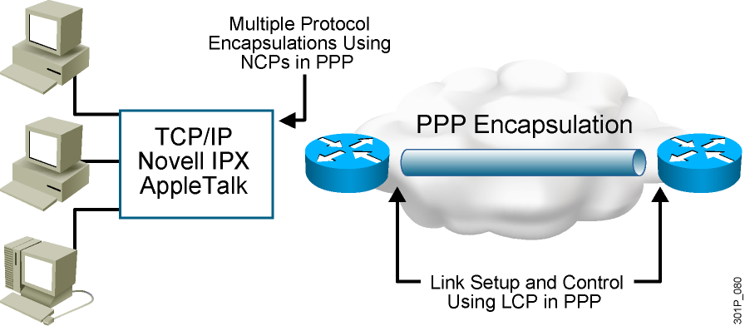
An Overview of PPP
PPP can carry packets from several protocol suites using NCP.
PPP controls the setup of several link options using LCP.
Notes:
Purpose: This figure presents an overview of PPP.
Emphasize: The figure illustrates the multiple protocols that NCP supports.
The two arrows pointing to the router interfaces are where PPP encapsulation occurs.
The first bullet summarizes the role of NCP. The second bullet summarizes the role of the LCP options that the administrator can use to set up and control the data link.
Several RFCs are used to specify aspects of PPP. RFC 1548 is the major specification for the major PPP NCP and LCP operations.

Slide 4
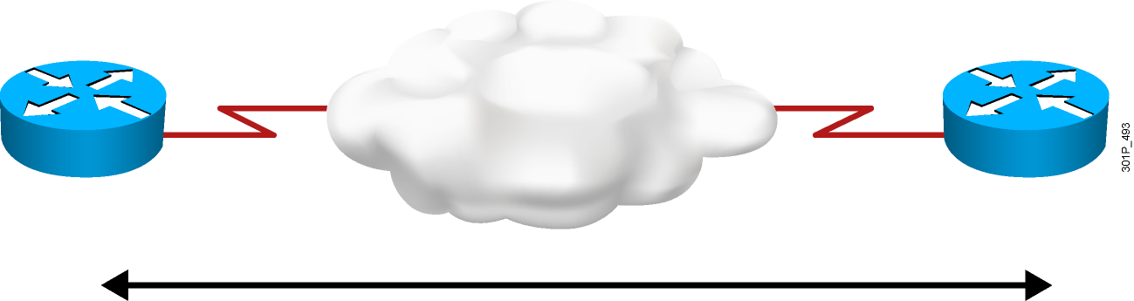
PPP Session Establishment
  PPP session establishment:
  Link establishment phase
  Authentication phase (optional)
    Two PPP authentication protocols: PAP and CHAP
  Network layer protocol phase
Notes:
Purpose: This graphic presents the PPP authentication overview.
Emphasize: A PPP session establishment has three phases, as follows:
Link establishment phase—In this phase, each PPP device sends LCP packets to configure and test the data link.
Authentication phase (optional)—After the link has been established and the authentication protocol decided on, the peer may be authenticated.
PPP supports two authentication protocols: PAP and CHAP.
Both of these protocols are detailed in RFC 1334, PPP Authentication Protocols. However, RFC 1994, PPP Challenge Handshake Authentication Protocol, obsoletes RFC 1334.
Network-layer protocol phase—In this phase, the PPP devices send NCP packets to choose and configure one or more network-layer protocol.

Slide 5
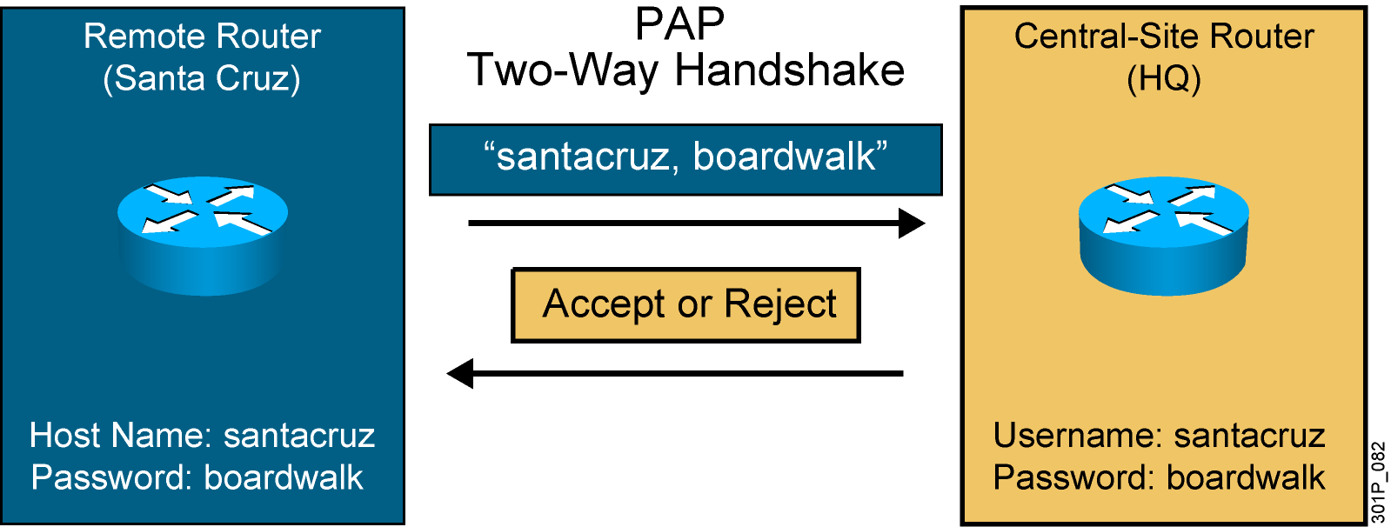
PPP Authentication Protocols: PAP
Passwords sent in plaintext
Peer in control of attempts
Notes:
Slide 1 of 2
Purpose: This figure presents the PPP authentication protocol, PAP.
Emphasize: PPP sets line controls for the call.
There are two types of authentication protocols: PAP and CHAP.
PAP provides a simple method for a remote node to establish its identity using a two-way handshake.
PAP is done only upon initial link establishment.
PAP is not a strong authentication protocol. It provides no encryption. It may be fine in DDR environments when the password changes each time a user authenticates.
CHAP is the preferred protocol.

Slide 6
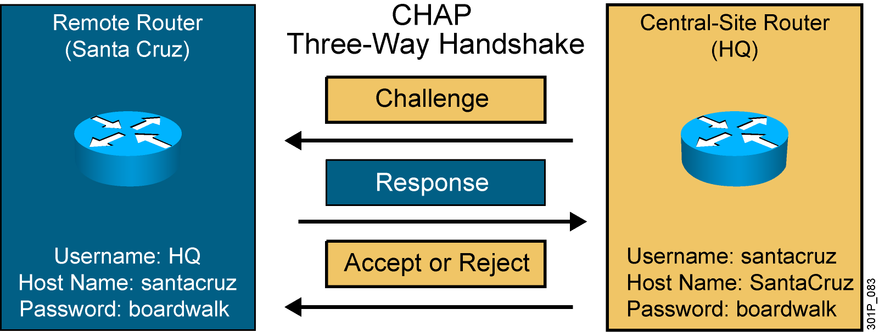
PPP Authentication Protocols: CHAP
This is an example of the Santa Cruz router authenticating to the HQ router.
Hash values, not actual passwords, are sent across the link.
The local router or external server is in control of authentication attempts.
Notes:
Slide 2 of 2
Purpose: This figure presents the PPP authentication protocol, CHAP.
Emphasize: CHAP is done upon initial link establishment and can be repeated any time after the link has been established.
CHAP transactions occur only when a link is established. The local access server does not request a password during the rest of the session. (The local access server can, however, respond to such requests from other devices during a session.)
CHAP is specified in RFC 1334. It is an additional authentication phase of the PPP Link Control Protocol.
Transition: Now that you know how PPP and PPP authentication operate, the following section describes how to configure these on a Cisco IOS router.

Slide 7
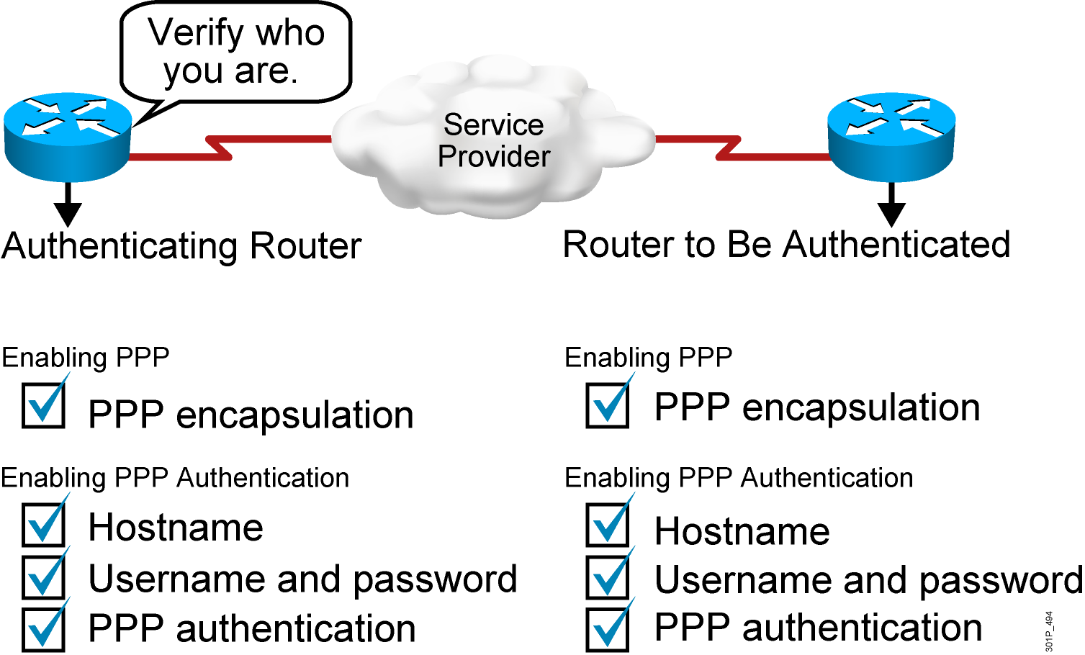
Configuring PPP and Authentication Overview
Notes:
Purpose: This figure provides a signpost highlighting the tasks you complete to enable PPP and PPP authentication.
Emphasize: Highlight the steps the student must take to enable PPP authentication.

Slide 8
Configuring PPP and Authentication
RouterX(config-if)# encapsulation ppp
Enables PPP encapsulation
RouterX(config)# hostname name
Assigns a hostname to your router
RouterX(config)# username name password password
Identifies the username and password of remote router
RouterX(config-if)# ppp authentication
{chap | chap pap | pap chap | pap}
Enables PAP or CHAP authentication
Notes:
Purpose: This figure describes how to encapsulate PPP on an interface.

Slide 9
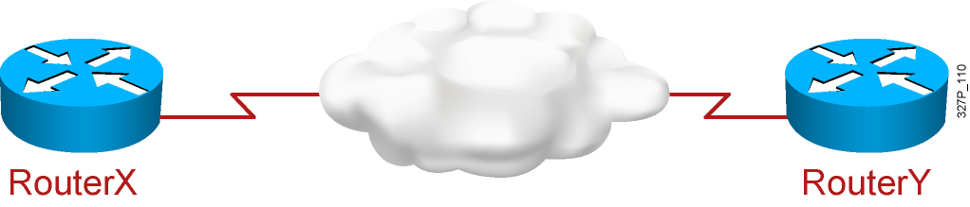
PPP and CHAP Configuration Example
hostname RouterX
username RouterY password sameone
!
int serial 0
ip address 10.0.1.1 255.255.255.0
encapsulation ppp
ppp authentication chap
hostname RouterY
username RouterX password sameone
!
int serial 0
ip address 10.0.1.2 255.255.255.0
encapsulation ppp
ppp authentication chap
Notes:
Purpose: This page shows an example of CHAP configuration between two routers.
Emphasize: When you configure the usernames and passwords for the local databases, the passwords on both systems must be identical. Usernames and passwords are case sensitive.
Transition: The next section shows how to verify that the connection is operating as intended.

Slide 10
Verifying the PPP Encapsulation Configuration
RouterX# show interface s0
Serial0 is up, line protocol is up
Hardware is HD64570
Internet address is 10.140.1.2/24
MTU 1500 bytes, BW 1544 Kbit, DLY 20000 usec, rely 255/255, load 1/255
Encapsulation PPP, loopback not set, keepalive set (10 sec)
LCP Open
Open: IPCP, CDPCP
Last input 00:00:05, output 00:00:05, output hang never
Last clearing of "show interface" counters never
Queueing strategy: fifo
Output queue 0/40, 0 drops; input queue 0/75, 0 drops
5 minute input rate 0 bits/sec, 0 packets/sec
5 minute output rate 0 bits/sec, 0 packets/sec
38021 packets input, 5656110 bytes, 0 no buffer
Received 23488 broadcasts, 0 runts, 0 giants, 0 throttles
0 input errors, 0 CRC, 0 frame, 0 overrun, 0 ignored, 0 abort
38097 packets output, 2135697 bytes, 0 underruns
0 output errors, 0 collisions, 6045 interface resets
0 output buffer failures, 0 output buffers swapped out
482 carrier transitions
DCD=up DSR=up DTR=up RTS=up CTS=up
Notes:
240 197 102

Slide 11
Verifying PPP Authentication
RouterX# debug ppp authentication
4d20h: %LINK-3-UPDOWN: Interface Serial0, changed state to up
4d20h: Se0 PPP: Treating connection as a dedicated line
4d20h: Se0 PPP: Phase is AUTHENTICATING, by both
4d20h: Se0 CHAP: O CHALLENGE id 2 len 28 from ”left"
4d20h: Se0 CHAP: I CHALLENGE id 3 len 28 from ”right"
4d20h: Se0 CHAP: O RESPONSE id 3 len 28 from ”left"
4d20h: Se0 CHAP: I RESPONSE id 2 len 28 from ”right"
4d20h: Se0 CHAP: O SUCCESS id 2 len 4
4d20h: Se0 CHAP: I SUCCESS id 3 len 4
4d20h: %LINEPROTO-5-UPDOWN: Line protocol on Interface Serial0, changed state to up
The debug ppp authentication command shows successful CHAP output
Notes:
Purpose: This page shows an example of debug ppp authentication output. The output illustrates a successful CHAP authentication challenge.
Emphasize: The debug ppp authentication command displays the authentication exchange sequence as it occurs.

Slide 12
Verifying PPP Negotiation
RouterX# debug ppp negotiation
PPP protocol negotiation debugging is on
RouterX#
*Mar 1 00:06:36.645: %LINK-3-UPDOWN: Interface BRI0:1, changed state to up
*Mar 1 00:06:36.661: BR0:1 PPP: Treating connection as a callin
*Mar 1 00:06:36.665: BR0:1 PPP: Phase is ESTABLISHING, Passive Open
*Mar 1 00:06:36.669: BR0:1 LCP: State is Listen
*Mar 1 00:06:37.034: BR0:1 LCP: I CONFREQ [Listen] id 7 len 17
*Mar 1 00:06:37.038: BR0:1 LCP: AuthProto PAP (0x0304C023)
*Mar 1 00:06:37.042: BR0:1 LCP: MagicNumber 0x507A214D (0x0506507A214D)
*Mar 1 00:06:37.046: BR0:1 LCP: Callback 0 (0x0D0300)
*Mar 1 00:06:37.054: BR0:1 LCP: O CONFREQ [Listen] id 4 len 15
*Mar 1 00:06:37.058: BR0:1 LCP: AuthProto CHAP (0x0305C22305)
*Mar 1 00:06:37.062: BR0:1 LCP: MagicNumber 0x1081E7E1 (0x05061081E7E1)
*Mar 1 00:06:37.066: BR0:1 LCP: O CONFREJ [Listen] id 7 len 7
*Mar 1 00:06:37.070: BR0:1 LCP: Callback 0 (0x0D0300)
*Mar 1 00:06:37.098: BR0:1 LCP: I CONFACK [REQsent] id 4 len 15
*Mar 1 00:06:37.102: BR0:1 LCP: AuthProto CHAP (0x0305C22305)
*Mar 1 00:06:37.106: BR0:1 LCP: MagicNumber 0x1081E7E1 (0x05061081E7E1)
*Mar 1 00:06:37.114: BR0:1 LCP: I CONFREQ [ACKrcvd] id 8 len 14
*Mar 1 00:06:37.117: BR0:1 LCP: AuthProto PAP (0x0304C023)
*Mar 1 00:06:37.121: BR0:1 LCP: MagicNumber 0x507A214D (0x0506507A214D)
Notes:
Purpose: This graphic presents the show interface command, which is used to verify that PPP encapsulation is configured on the interface. The same command is used to verify proper HDLC configuration.

Slide 13
Summary
  PPP is a common Layer 2 protocol for the WAN. There are two components of PPP: LCP negotiates the connection and NCP encapsulates traffic.
  You can configure PPP to use PAP or CHAP. PAP sends everything in plaintext. CHAP uses an MD5 hash.
  Common PPP verification commands include show interface to verify PPP encapsulation and debug ppp negotiation to verify the LCP handshake.

